Slide 1


Intro to
Python

Slide 2

Good Morning Everyone

Slide 3

Who am I?
I am Bhaskar Bhar
I am in BTECH sem 7
I am an open source enthusiast, I have done contributions in nDPI and Zeek.
Linkedin: Just search Bhaskar Bhar(You will find a odd looking guy with specs wearing red tshirt)
Github username:
bhaskarbhar

Slide 4

Sooo, What is Python??
Its just a programming language which is run by its own virtual environment, thats all.
semicolon(;), we dont do zat here

Slide 5

What are the features of Python??

Slide 6
Its an interpreted programming language, that means line by line code is executed
Its Open Source, that is you can build your own libraries
Huge number of libraries for nearly every purpose
Easy to code, even chatgpt answers in python first if you dont mention to use other language

Slide 7
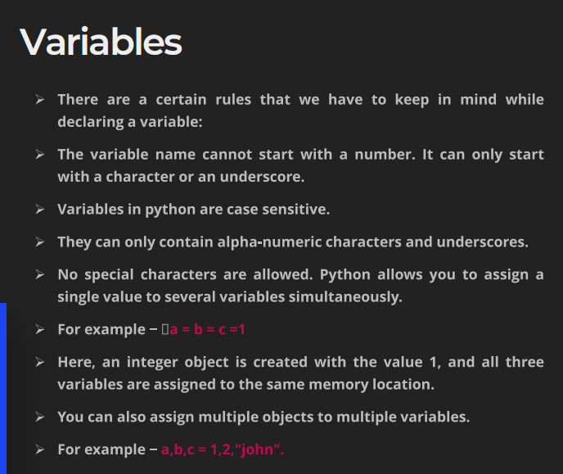
Variables are symbolic names that act as containers or labels for values stored in the computer's memory.

Slide 8
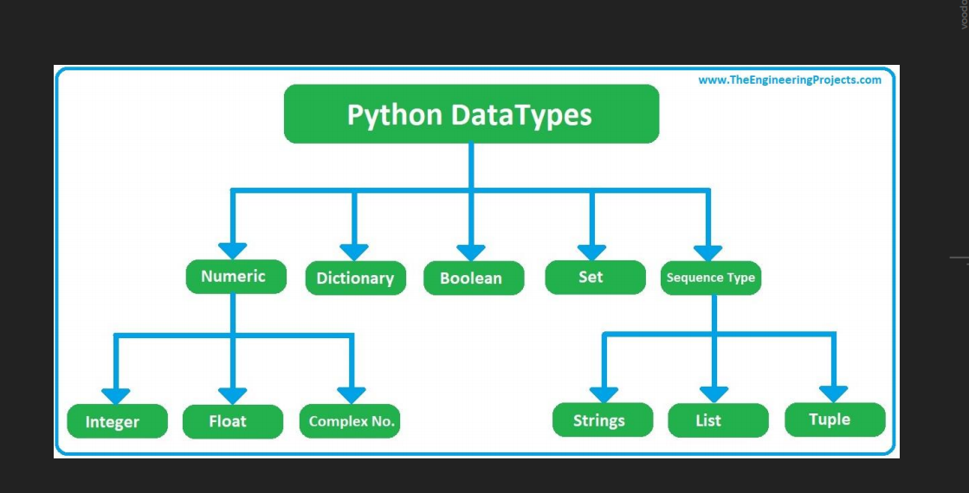

Slide 9
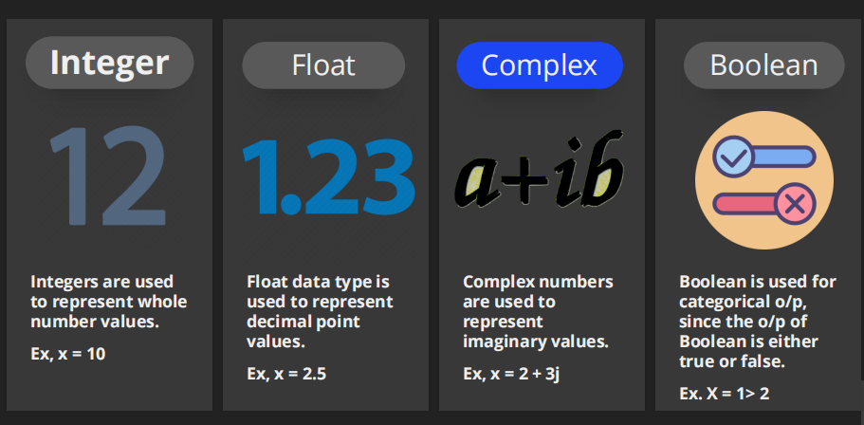

Slide 10

Python Operators
❖ Arithmetic operators
❖ Assignment operators
❖ Comparison operators
❖ Logical operators
❖ Identity operators
❖ Membership operators
❖ Bitwise operators

Slide 11
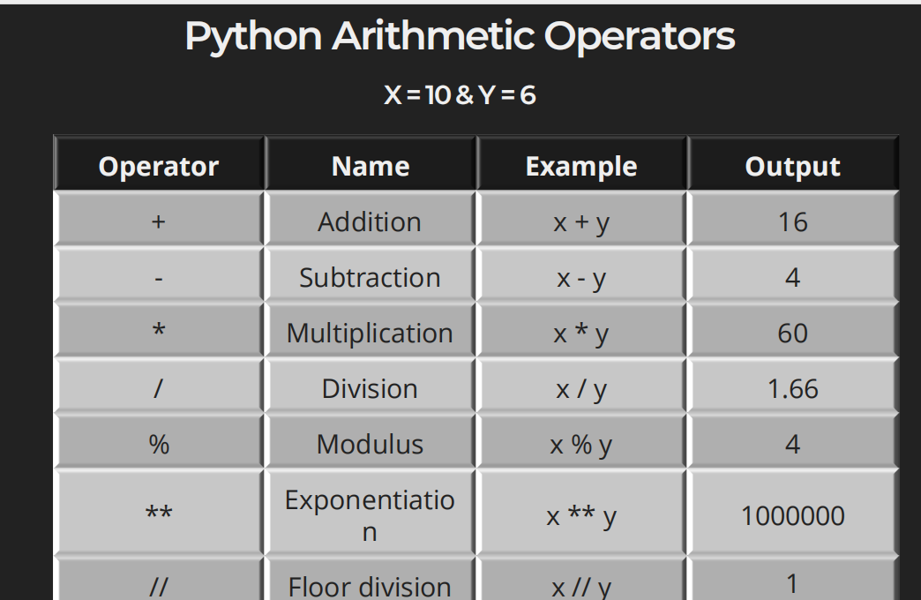

Slide 12
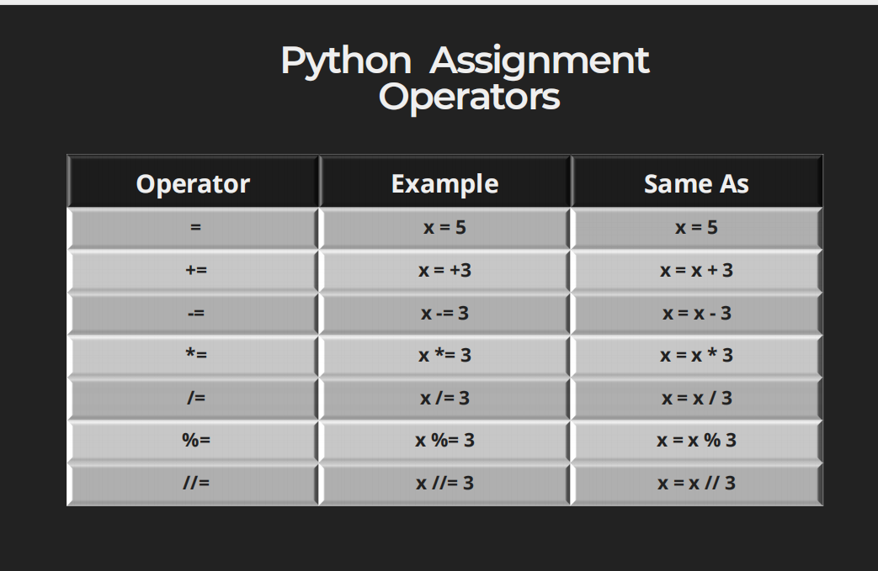

Slide 13
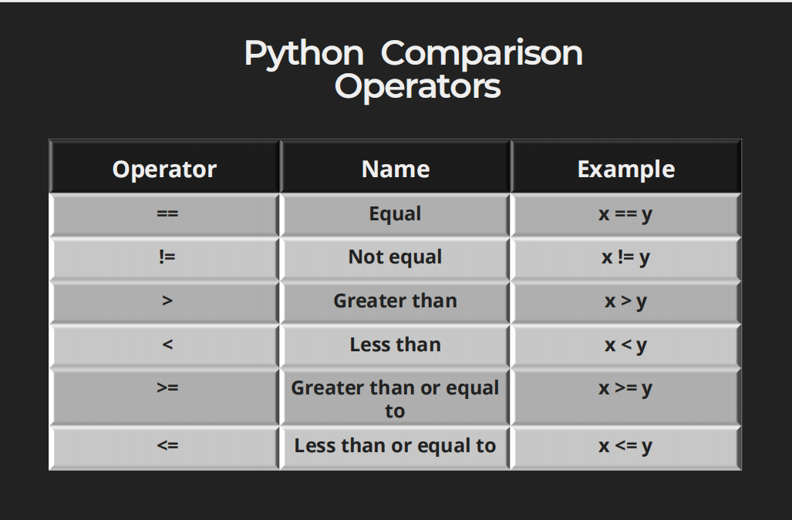

Slide 14
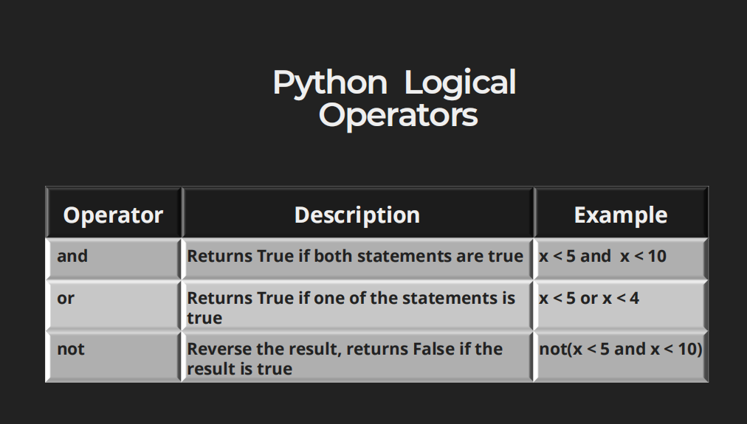

Slide 15
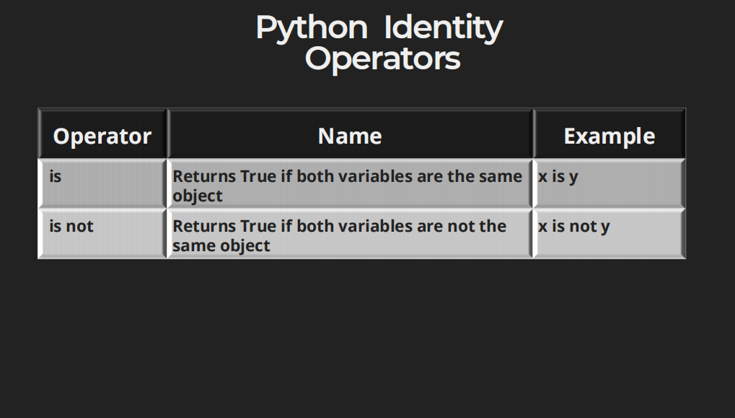

Slide 16
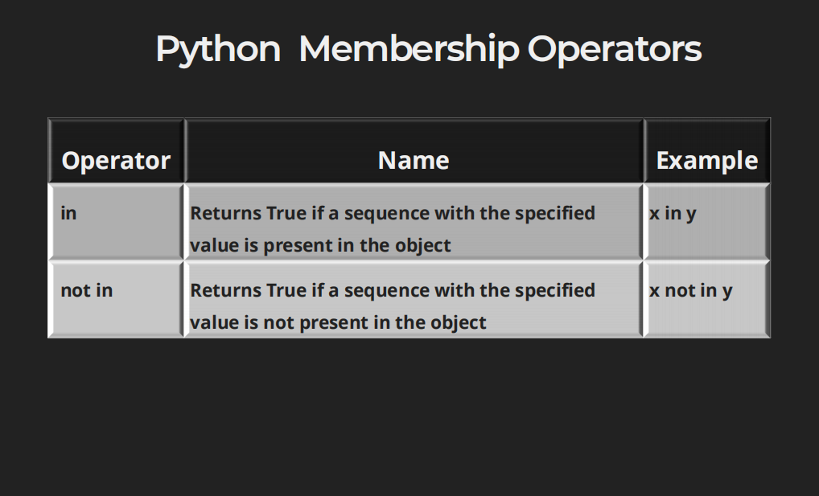

Slide 17
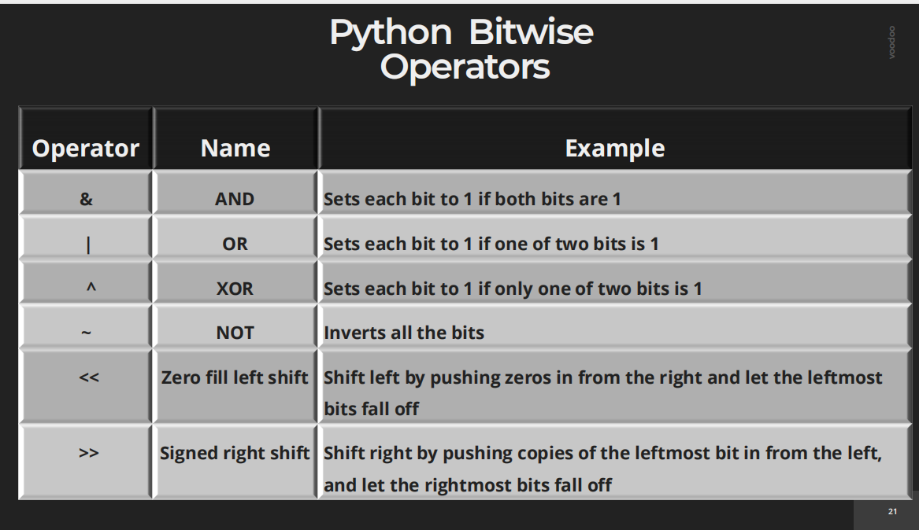

Slide 18

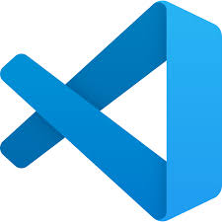
Python Branching
For this we will code!!!!
Please open your IDE
❖If statement
❖ Elif Statement
❖ Else statement

Slide 19
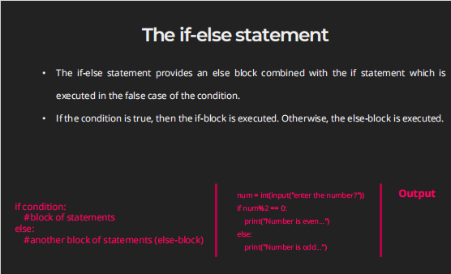

Slide 20


Python Iteration
❖ While loop
❖ For loop
❖ Continue and Break
I meet someone
For this we will code!!!!
Please open your IDE
We talk
They Leave
Realizes I am Sosuke Aizen

Slide 21
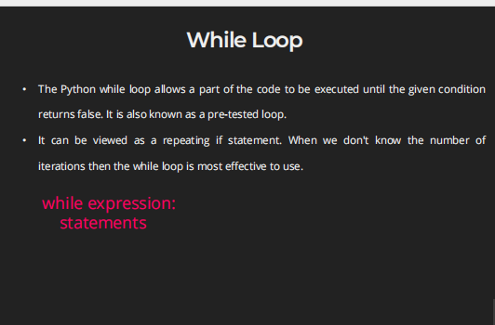

Slide 22
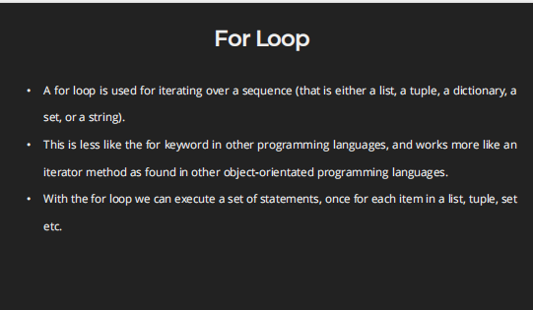

Slide 23
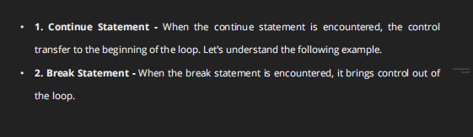

Slide 24
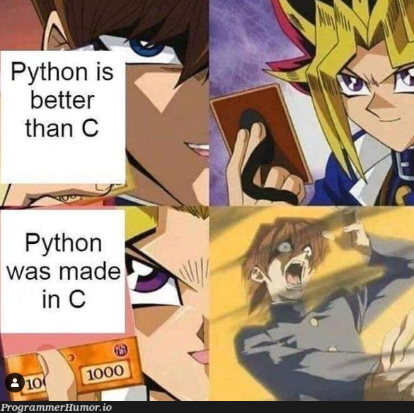
BASIC SEQUENTIAL DATA TYPES
Strings
List
Tuple
Dictionary
For this we will code!!!!
Please open your IDE

Slide 25
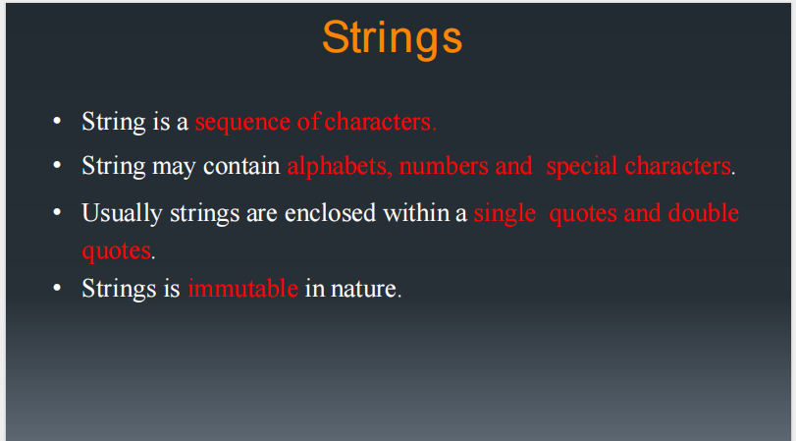

Slide 26
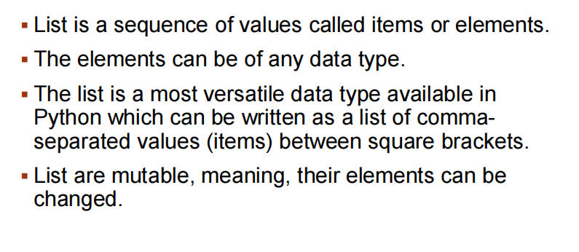

Slide 27
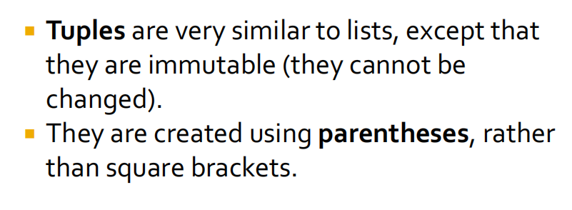

Slide 28
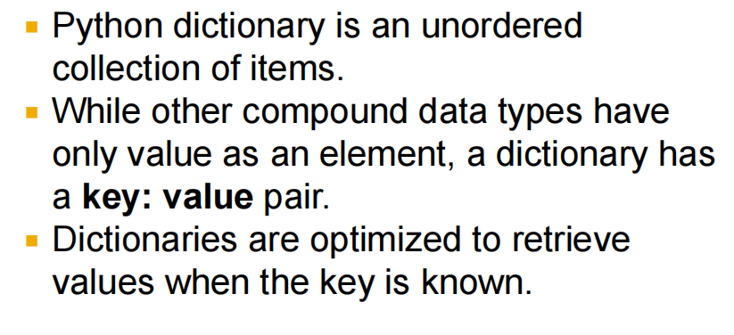

Slide 29

Libraries
for ML and data Analysis

Slide 30

random
The random module in Python is part of the standard library.
It is used to generate pseudo-random(We can give seeds) numbers and perform random operations such as shuffling, selecting random items, or generating distributions.
random.random()
Returns a float between 0.0 and 1.0.
random.randint(a, b)
Returns a random integer between a and b (inclusive).
random.choice(seq)
Returns a random element from a list, tuple, or string.

Slide 31





Numpy(Numerical Python)
To understand this module lets understand what is an array? And why its different from list?
Array is a data type allowing only homogenous data or data of same data type
[
,
,
,
,
]
Whereas List allows heterogenous data
[
]
,
,
,
,

Slide 32
Why numpy arrays are faster??
Reason 1:
Contiguous memory allocation
0x1
0x2
0x3
0x4
0x5
0x6
In lIst:
0x1
0x2
0x3
0x4
0x5
0x6

Slide 33
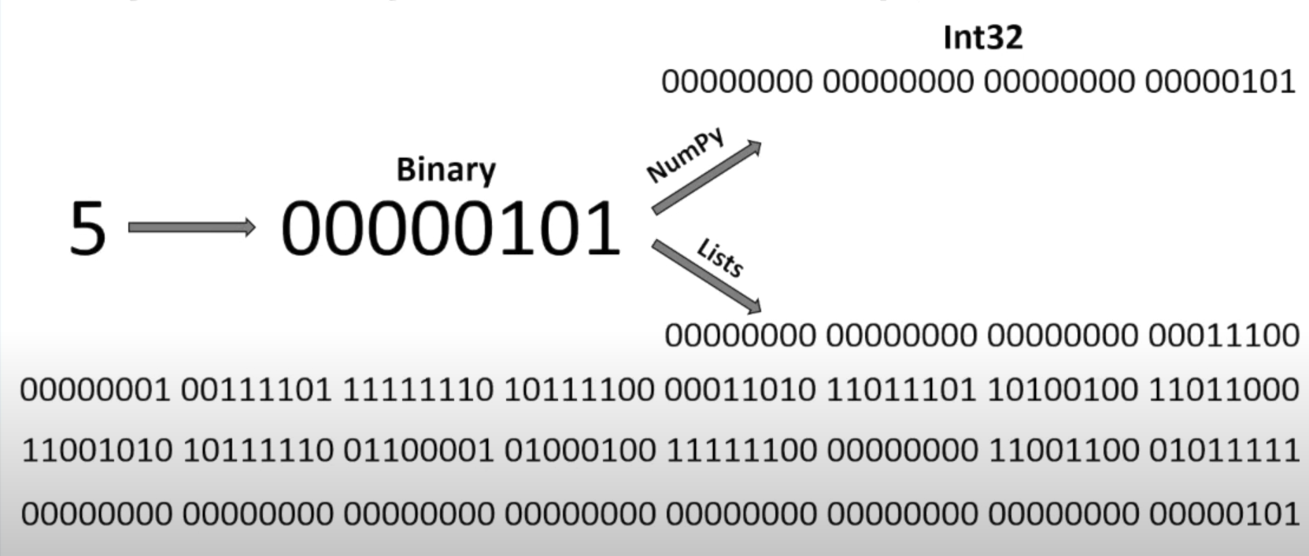
Reason 2:
Size and Fixed Type
List actually maintains 4 things:
Size
Reference Count
Object Type
Object Value

Slide 34
numpy.array() → Create an array
Used to create a NumPy array from a list or tuple.
ndim → Number of dimensions
Tells how many dimensions (axes) an array has.
shape → Dimensions of the array
Returns a tuple showing the rows × columns (for 2D) or sizes along each axis.
size → Total number of elements
Gives the count of all elements in the array.

Slide 35

pandas
Pandas is a powerful open-source Python library used for data analysis and manipulation.
It is built on top of NumPy, and provides high-level data structures and functions designed to make working with structured/tabular data easy.
The two main data structures in Pandas are:
Series → one-dimensional labeled array (like a column).
DataFrame → two-dimensional labeled data (like an Excel table).
Why Pandas is Important in Data Analysis / DS?????
Data Cleaning → handle missing values, duplicates, inconsistent data.
Exploration → summary statistics (.mean(), .describe()).
Manipulation → filtering, grouping, merging datasets.
Integration → works with CSV, Excel, SQL, JSON, etc.

Slide 36
pd.Series() → Create a Series
A one-dimensional labeled array.
pd.DataFrame() → Create a DataFrame
A two-dimensional labeled table.
df.head() → View first rows of data
Shows the first 5 rows (default), useful for quickly inspecting data.
df.shape → Shape of the DataFrame
Returns a tuple (rows, columns).
df.columns → List of column labels
Gives the names of all columns.

Slide 37
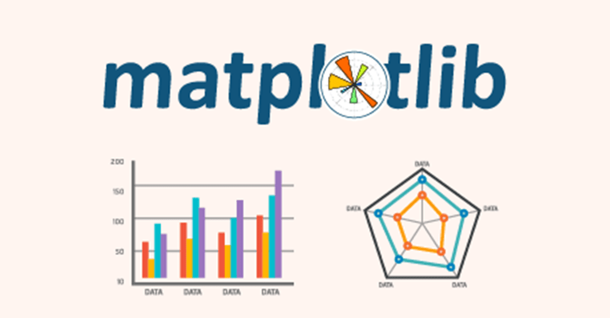
matplotlib
Matplotlib is the most widely used data visualization library in Python.
We will loook examples for the submodule for pyplot
Basic Pyplot Usage
import matplotlib.pyplot as plt
# Sample data
x = [1, 2, 3, 4, 5]
y = [2, 4, 6, 8, 10]
# Line plot
plt.plot(x, y, label="Line")
plt.xlabel("X-axis")
plt.ylabel("Y-axis")
plt.title("Basic Line Plot")
plt.legend()
plt.show()

Slide 38
Google Colab Notebook Link:
https://colab.research.google.com/drive/1Bf0MB_0mHspX2hHPcH583A5AggrquJyW?usp=sharing
Or
https://shorturl.at/3pYgn

Slide 39


